Slide 1


Data Analyst Positions Job Listing
QueryCrafters (Group7)
Cheung Hang Mang, Jeff
Wong Tat Hang, Hector
Exploratory Data Analysis (EDA) Mini Project
by Christian Action Training Services

Slide 2
Data Collection and Preprocessing
Data Gathering
Data Cleaning
Scraped Glassdoor job listings for 'Data Analyst Jobs' by Kaggle.
Handling missing values, outliers, and formatting data for analysis.
Data Integration
Data Transformation
Combining data from different format into a unified dataset.
Converting and preparing data for analysis and modeling.

Slide 3

Exploratory data analysis techniques
Data Cleaning: Identify and handle missing data, outliers, and duplicates.
Summary Statistics: Calculate mean, median, mode, and variance for initial insights.
Correlation Analysis: Explore relationships between variables using correlation coefficients.

Slide 4
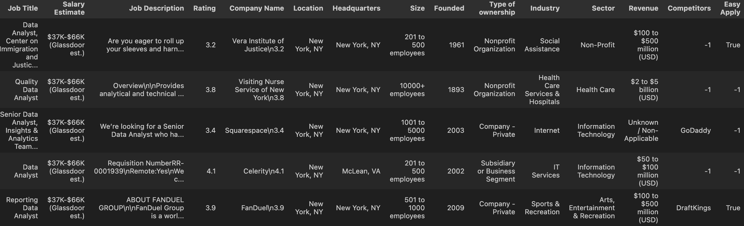
Data Cleaning
Salary Estimate
Company Name
Rating scale
The "Salary Estimate" column contains salary ranges in the format of "$37K-$66K (Glassdoor est.)"
The "Company Name" column encounter some issues such as inconsistent formatting or special characters. (“\n”+Rating)
Evaluating model performance involves analyzing precision-recall and ROC curves to make informed decisions about the predictive power and trade-offs of each model.

Slide 5
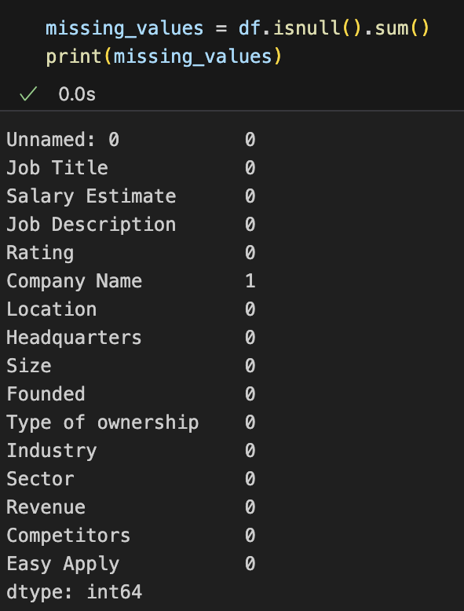
Missing Values
In this dataset, there is one missing value in the 'Company Name' column.
After careful consideration, we have chosen to ignore this missing value for our analysis, as it constitutes only a small portion of the overall data and its absence does not significantly impact the key insights we seek to derive from the dataset.

Slide 6
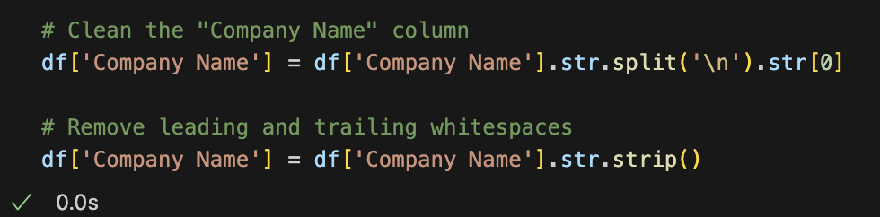
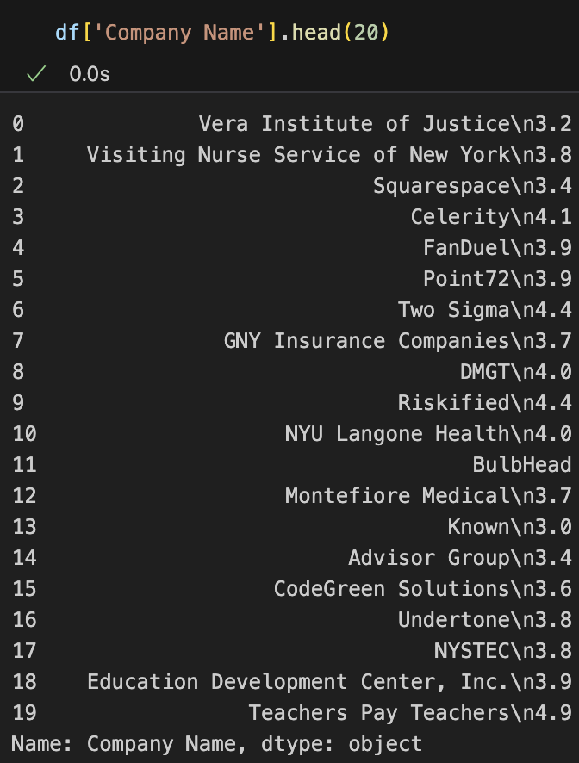
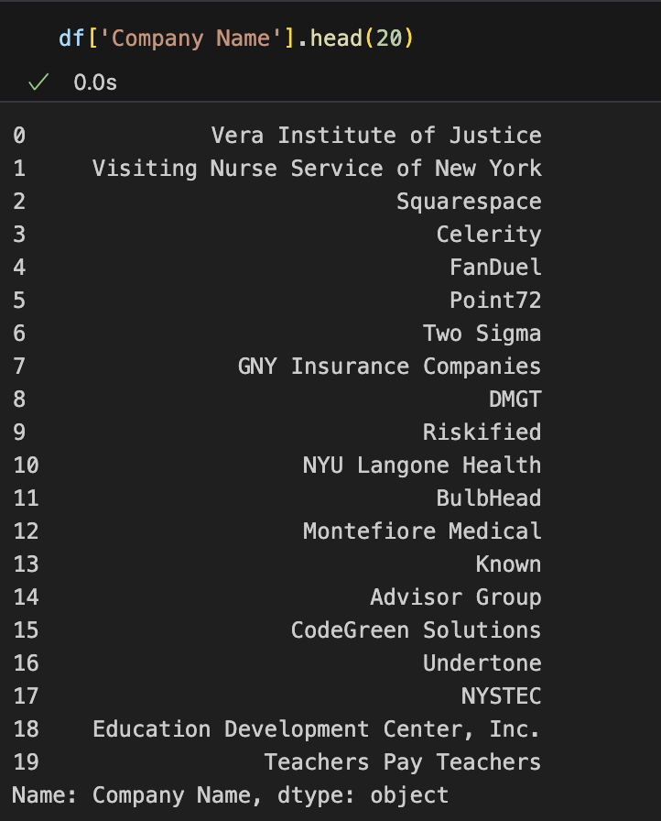
Data Cleaning
Raw Data
After Cleaning
Splitting the "Company Name" column based on the "\n" character and selecting the first part of the split, then removing any leading or trailing whitespaces from each element in the "Company Name" column.

Slide 7

Data visualization methods
1
Pandas
It provides a simple interface to create common plots such as
line plots, bar plots, and scatter plots directly from pandas DataFrames
2
Matplotlib
It provides a wide range of plot types, including line plots, scatter plots,
bar plots, histograms, and many more.
3
Seaborn
Simplifies the process of creating complex visualizations such as
heatmaps, violin plots, box plots, and regression plots.

Slide 8
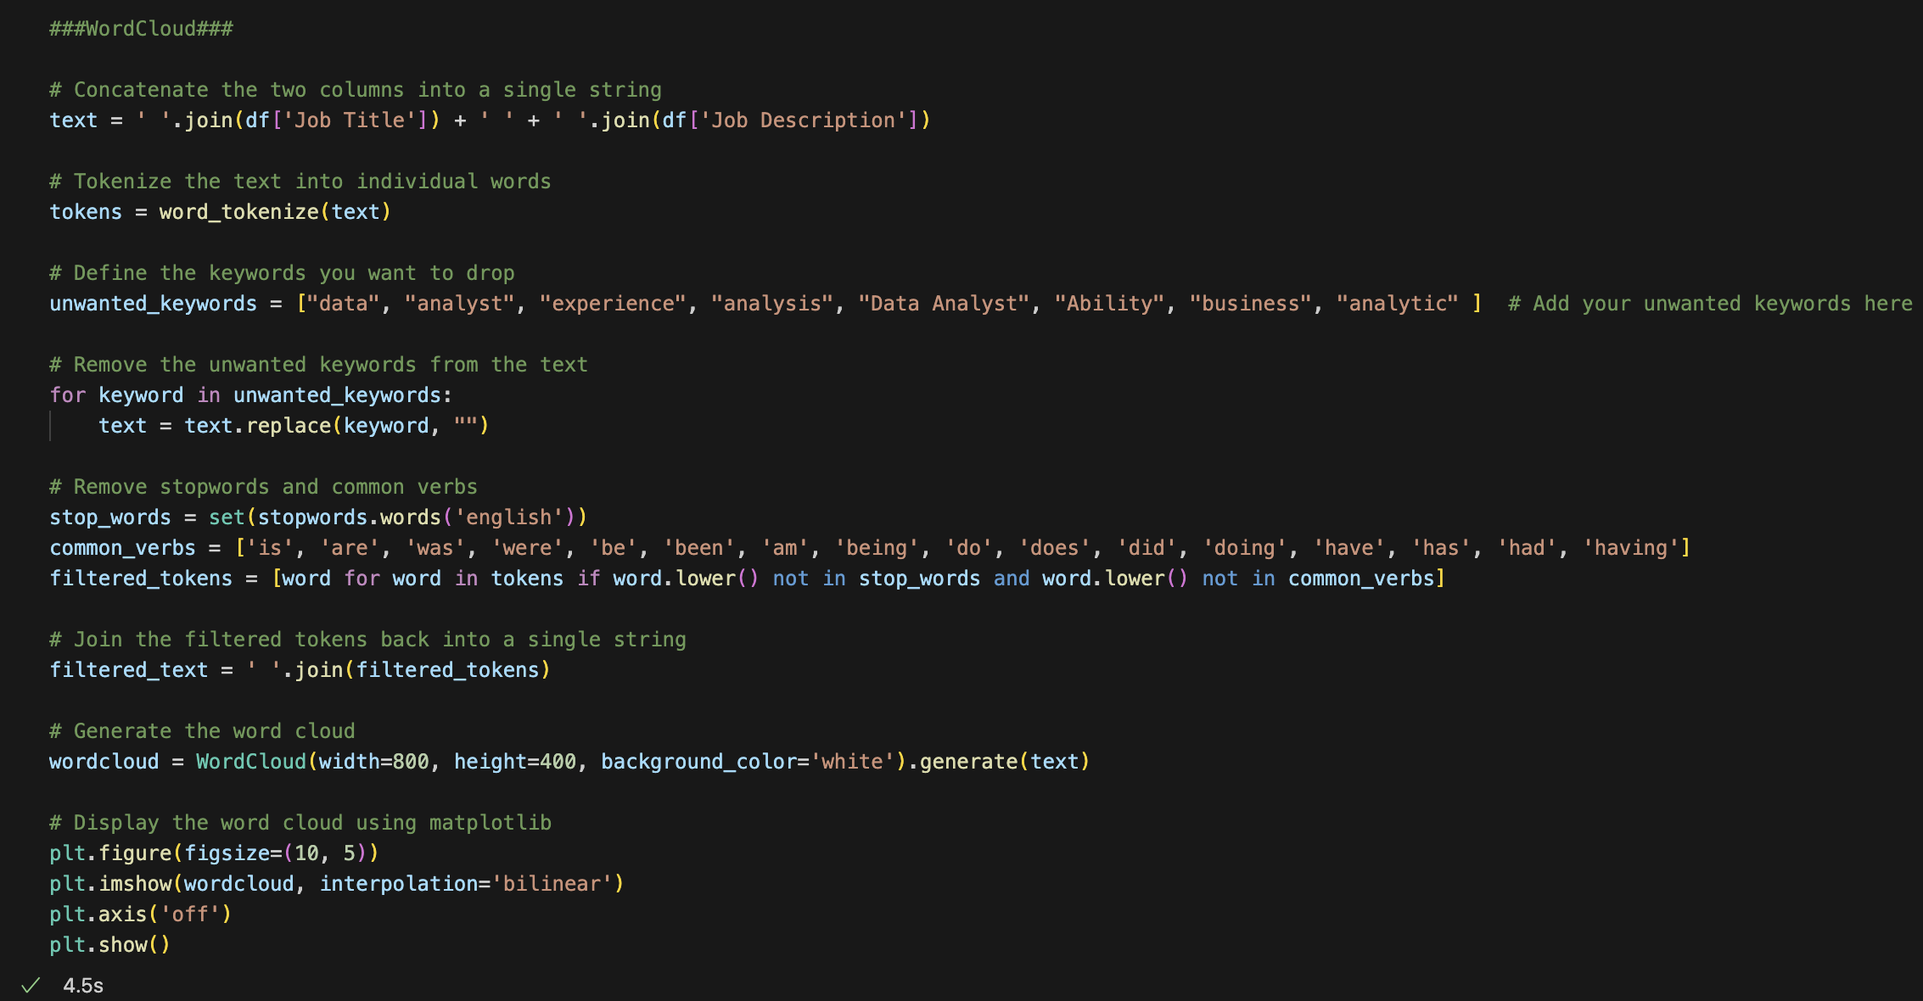
Most Frequency Words

Slide 9

Most Frequency Words
Represents the frequency of words in a text corpus by displaying them as different-sized words in a cloud-like arrangement, where the size of each word corresponds to frequency.
Based on the words of mentioned, it appears that the text data you used for generating the word cloud is related to a context where teamwork, client interaction, support, and projects are important. These words likely have higher frequencies in the text, indicating their significance or prominence.

Slide 10
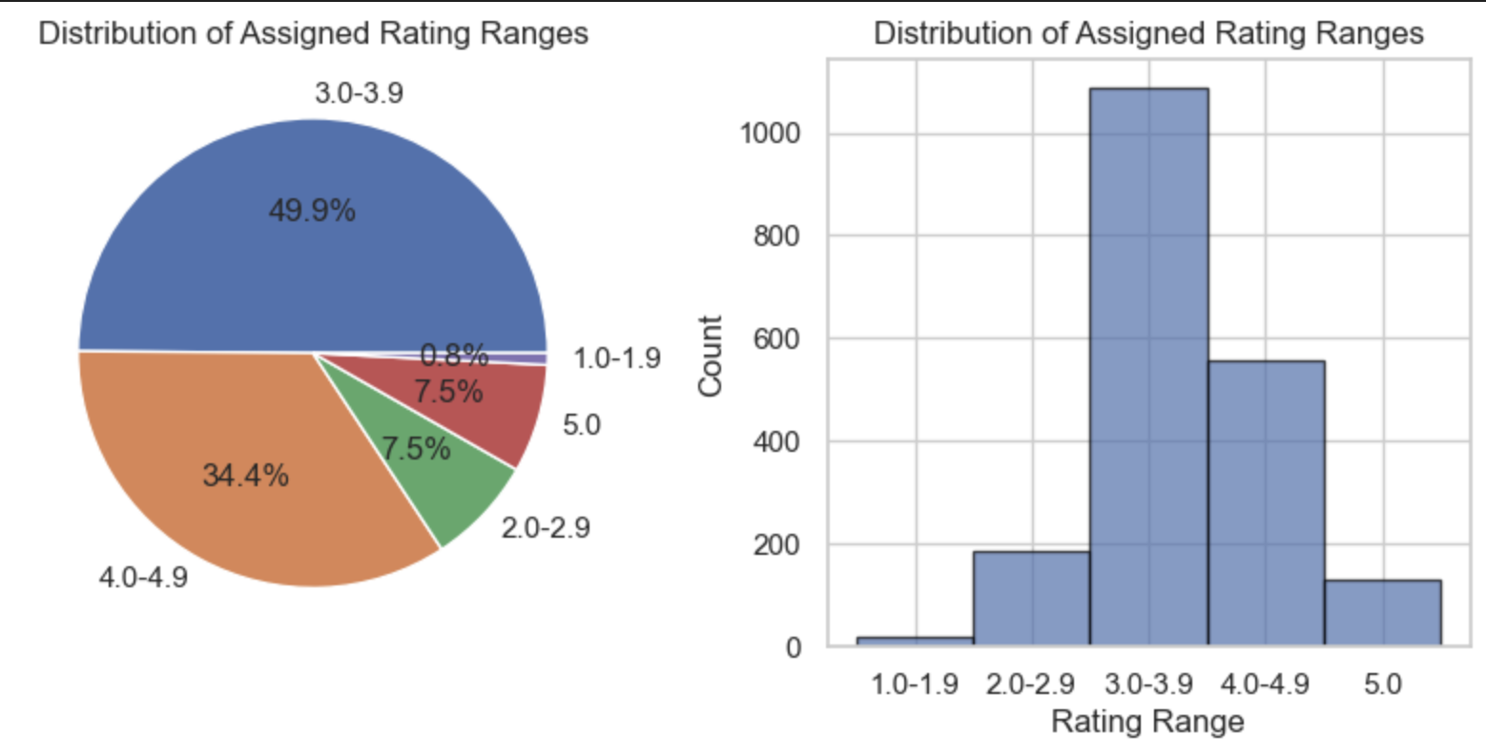
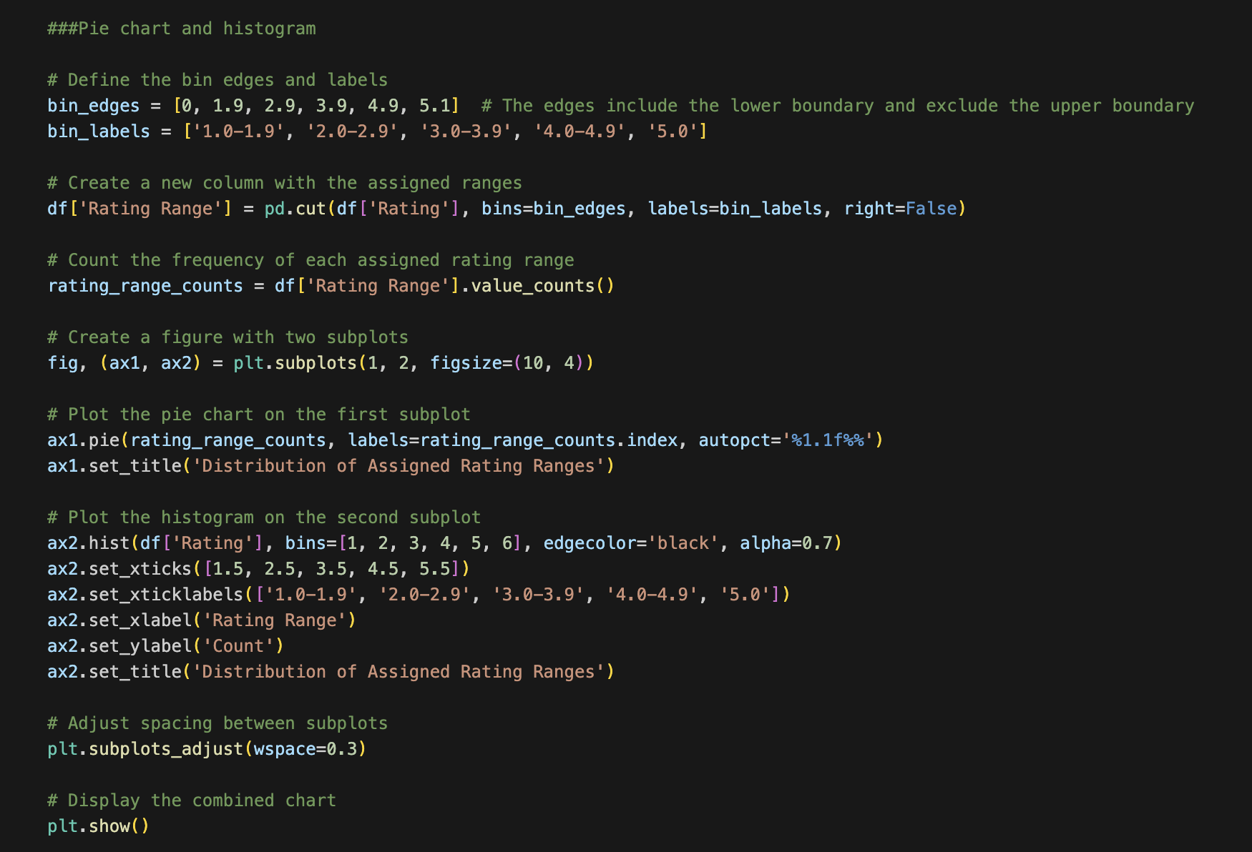
Distribution Assigned Rating
The histogram displays the frequency distribution of the assigned rating ranges, illustrating the count of ratings falling within each range category.
The pie chart visually represents the distribution of assigned rating ranges in the dataset, showing the percentage of each rating range category.

Slide 11
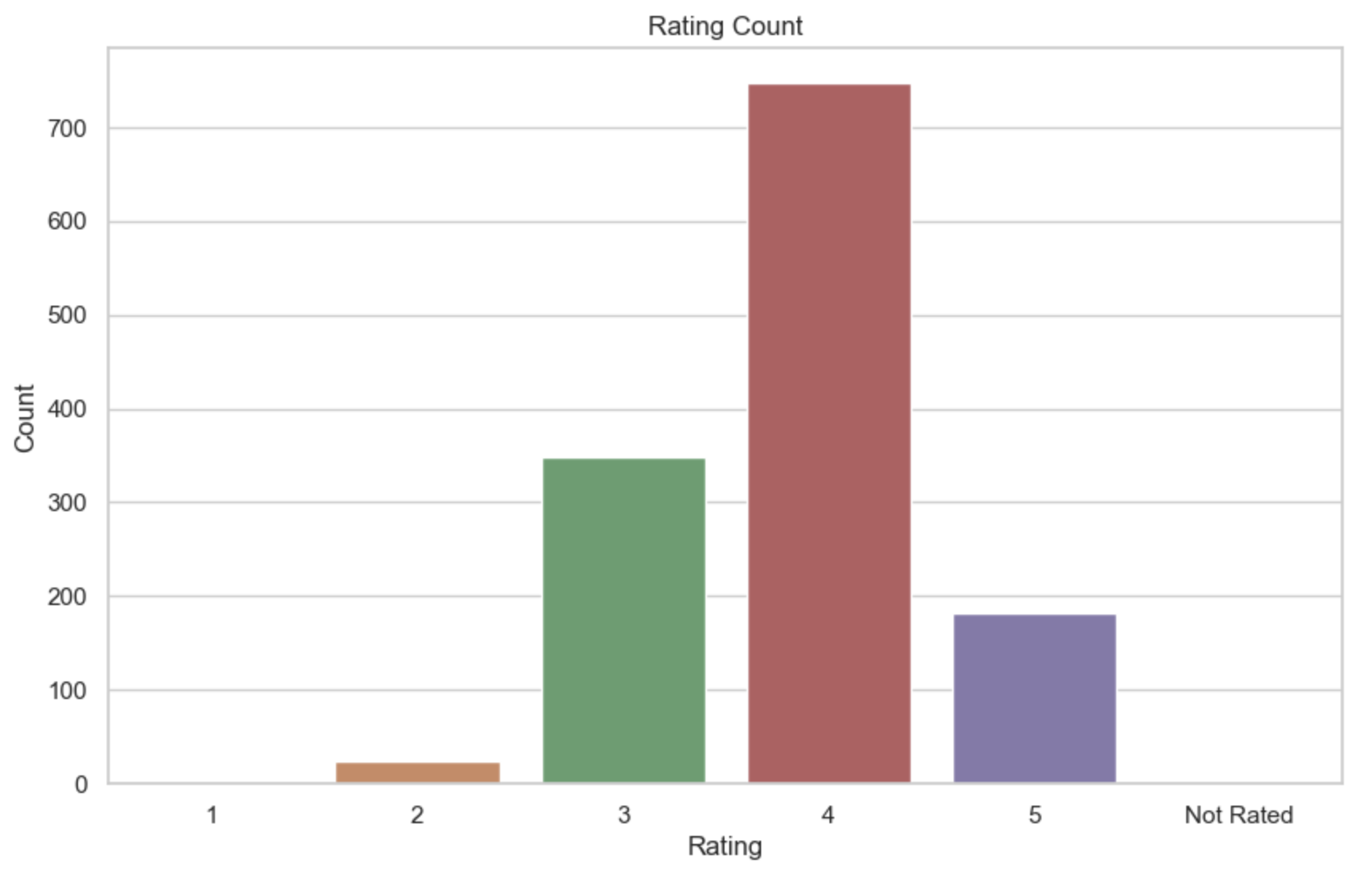
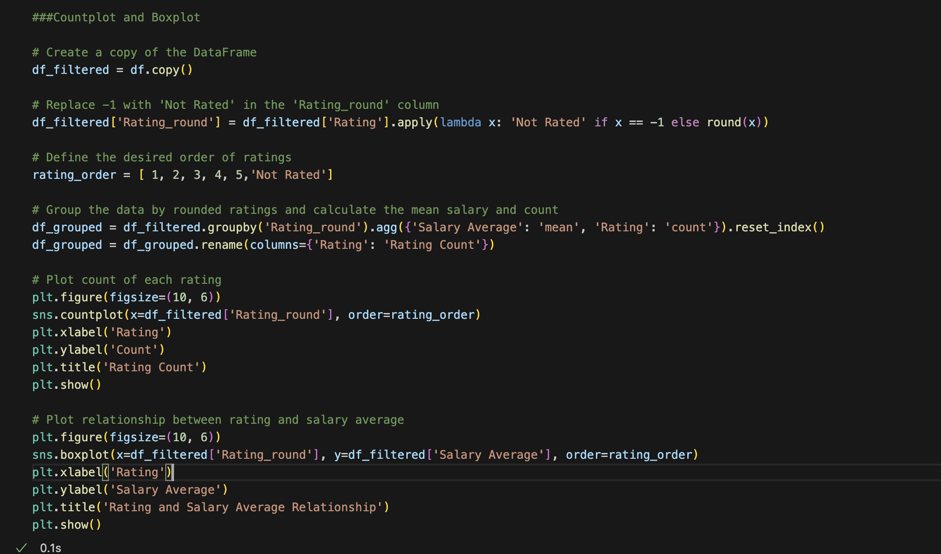
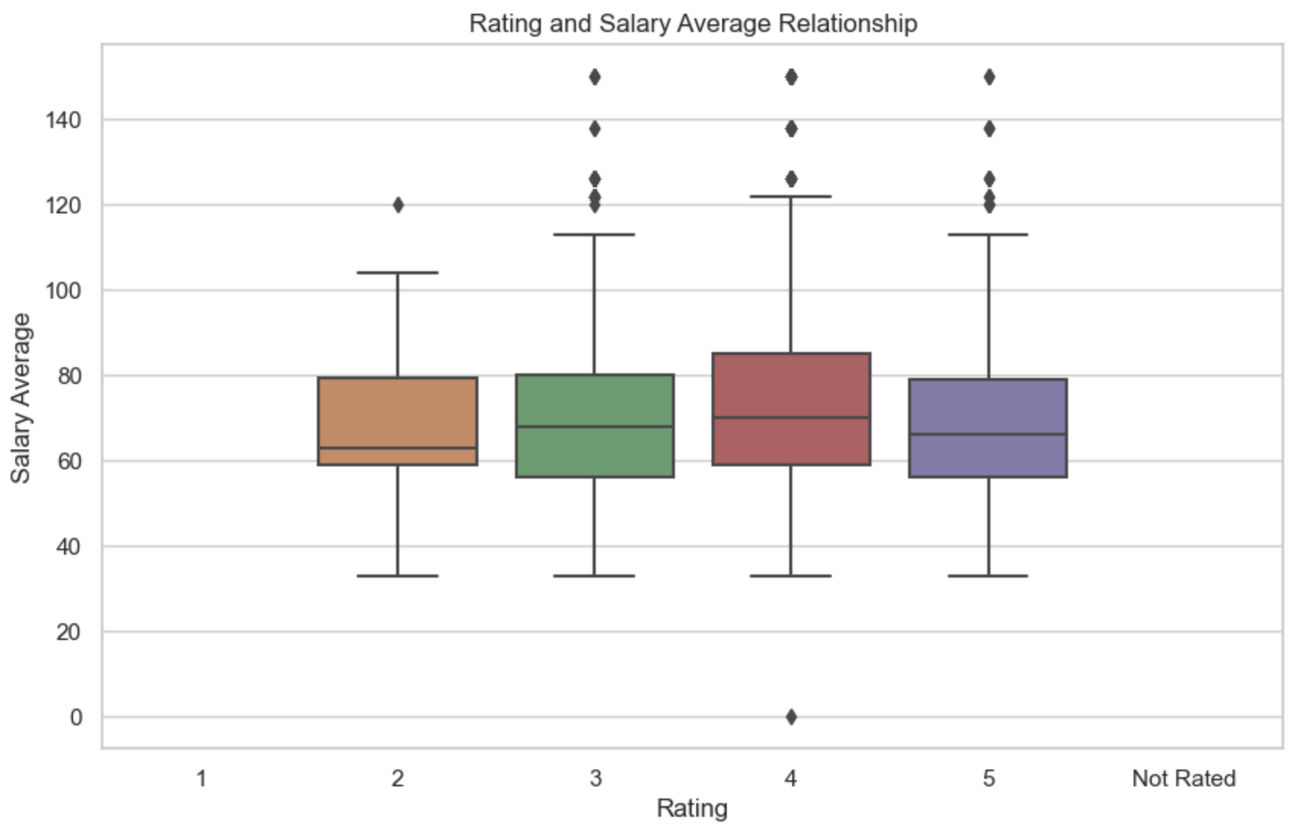
Rating and Salary Average Relationship
A boxplot visually depicts the relationship between rating categories and average salaries, revealing variations or trends in salary distribution. A bar chart displays the count of each rating category, giving an overview of the distribution of ratings in the dataset.

Slide 12
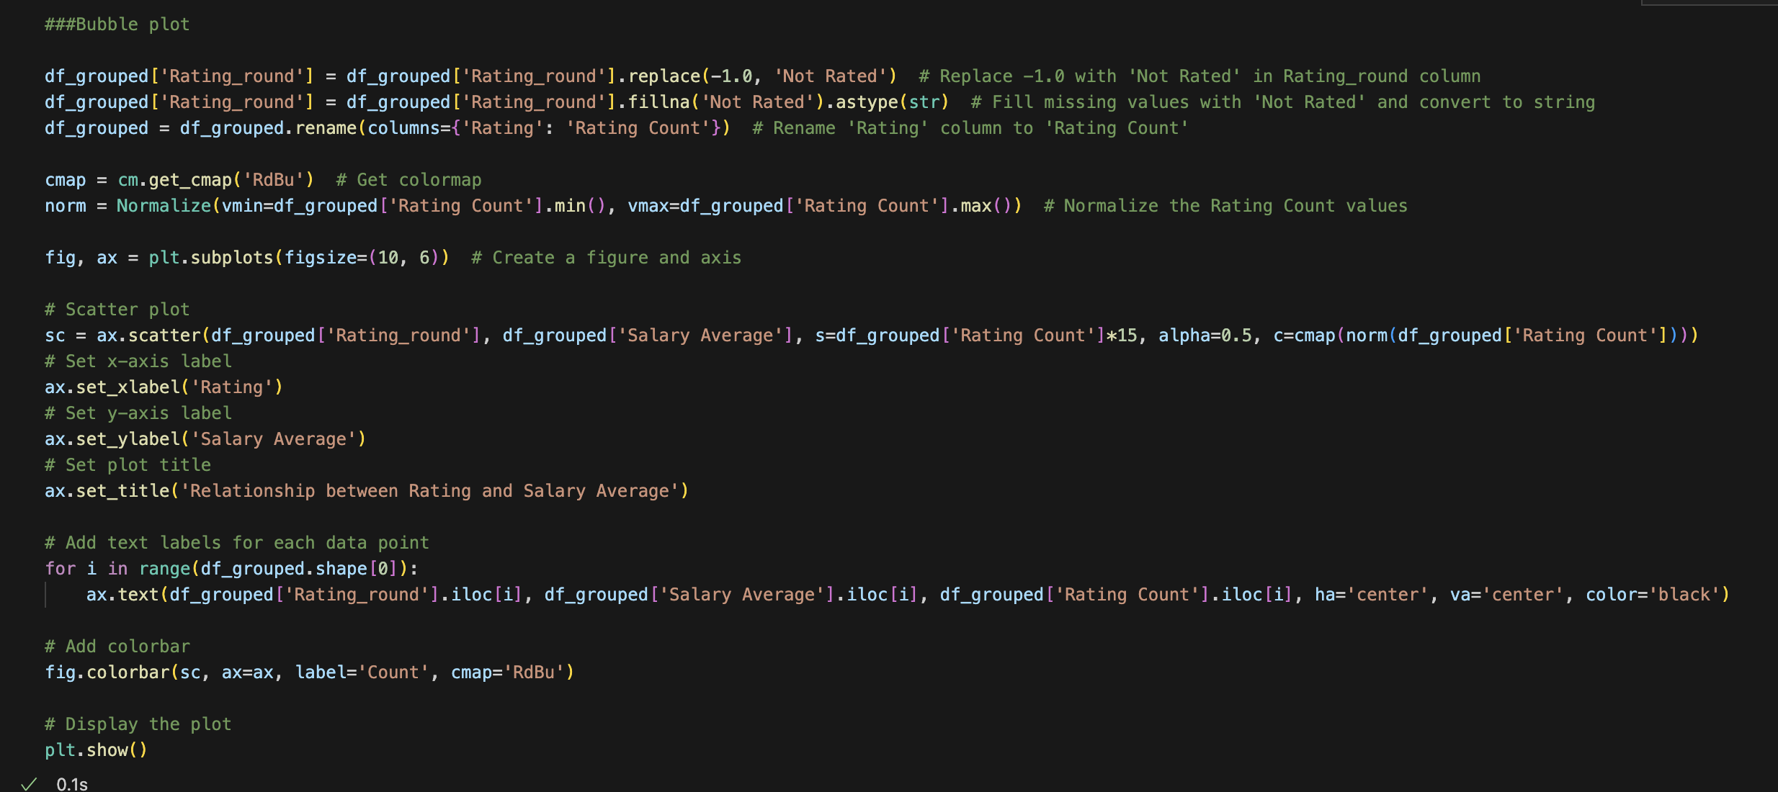
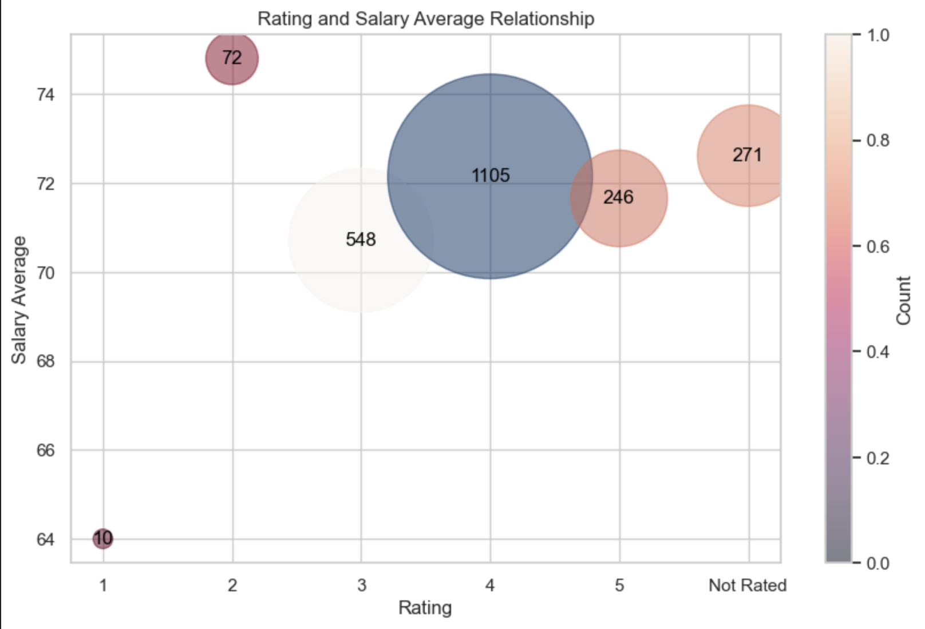
Rating and Salary Relationship (Bubble plot)
This bubble plot showcases the relationship between the average salary and rating count for different categories, with bubble sizes indicating the rating count and colors representing the normalized rating count values

Slide 13
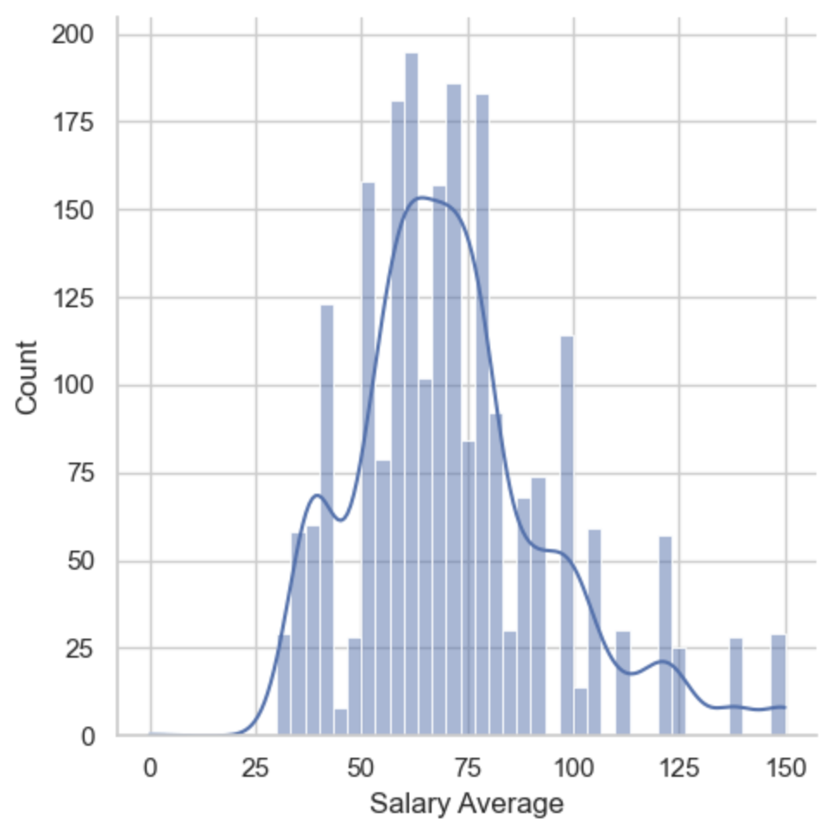
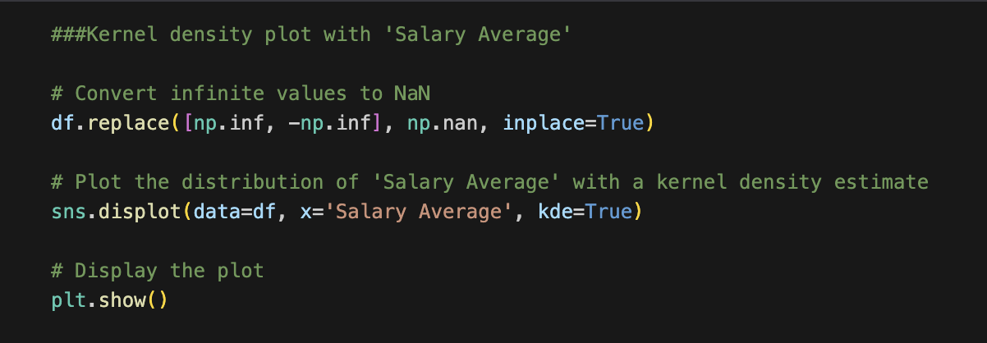
Salary Average Kernel density plot (KDE)
KDE provides a smooth and continuous estimation of the probability density function, allowing us to visualize the distribution of the 'Salary Average' variable in our dataset.
KDE plot of the 'Salary Average' variable provides a visual representation of its distribution, allowing us to observe the concentration and spread of salary averages within the dataset.

Slide 14
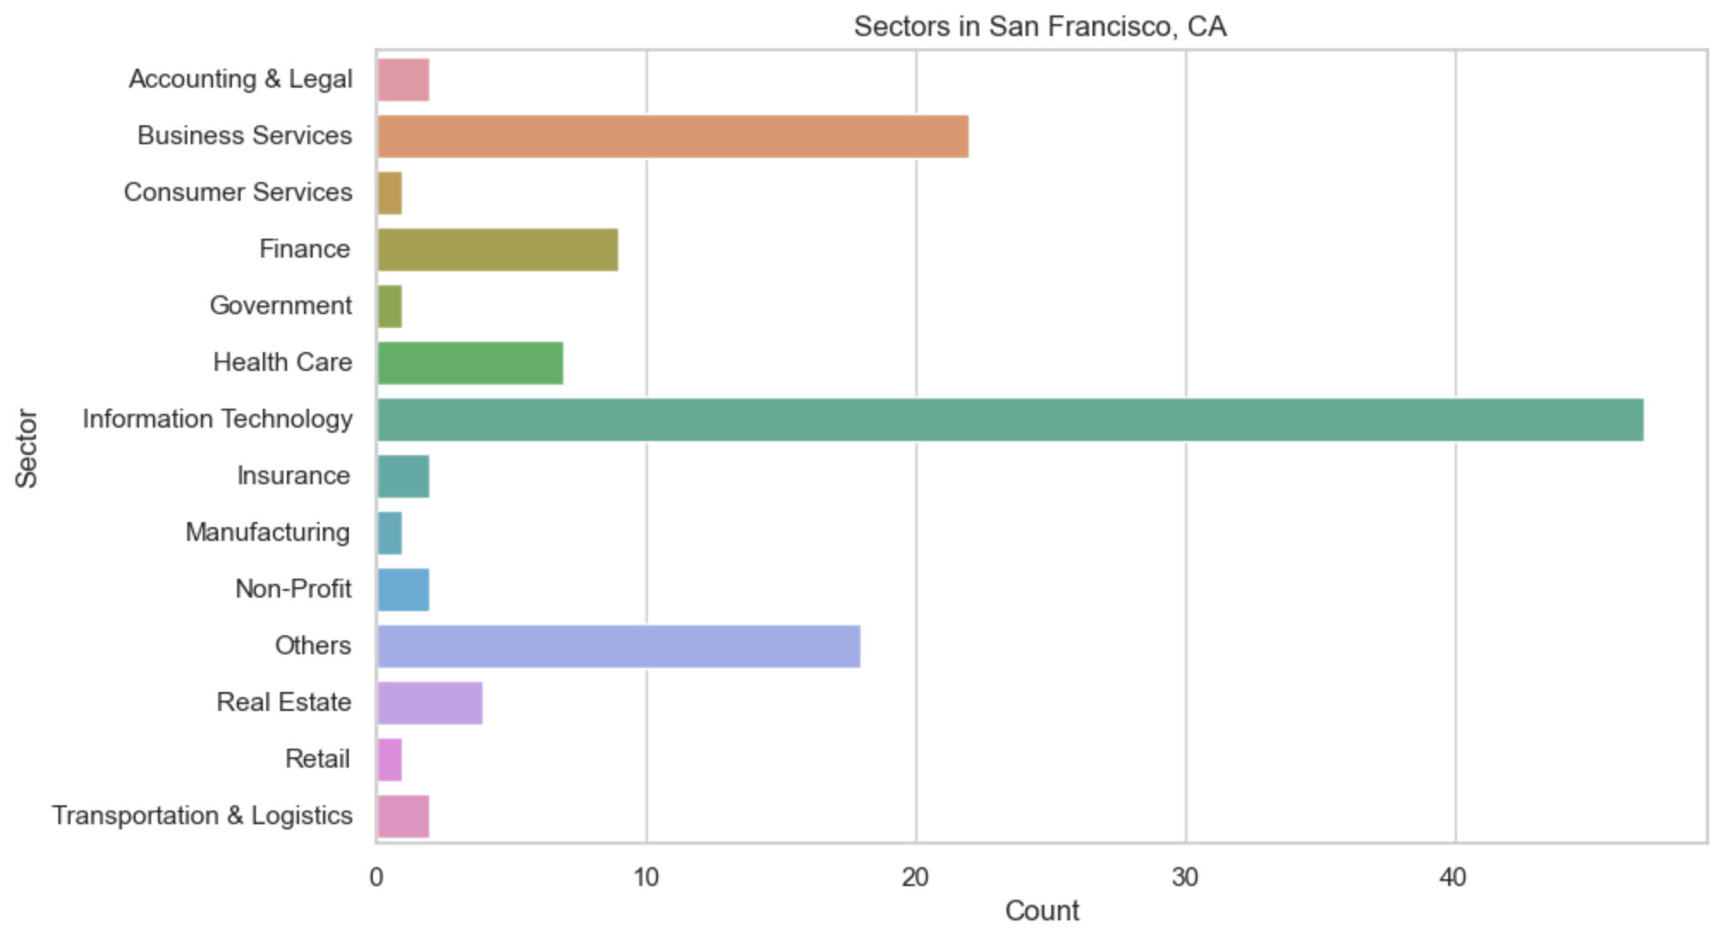
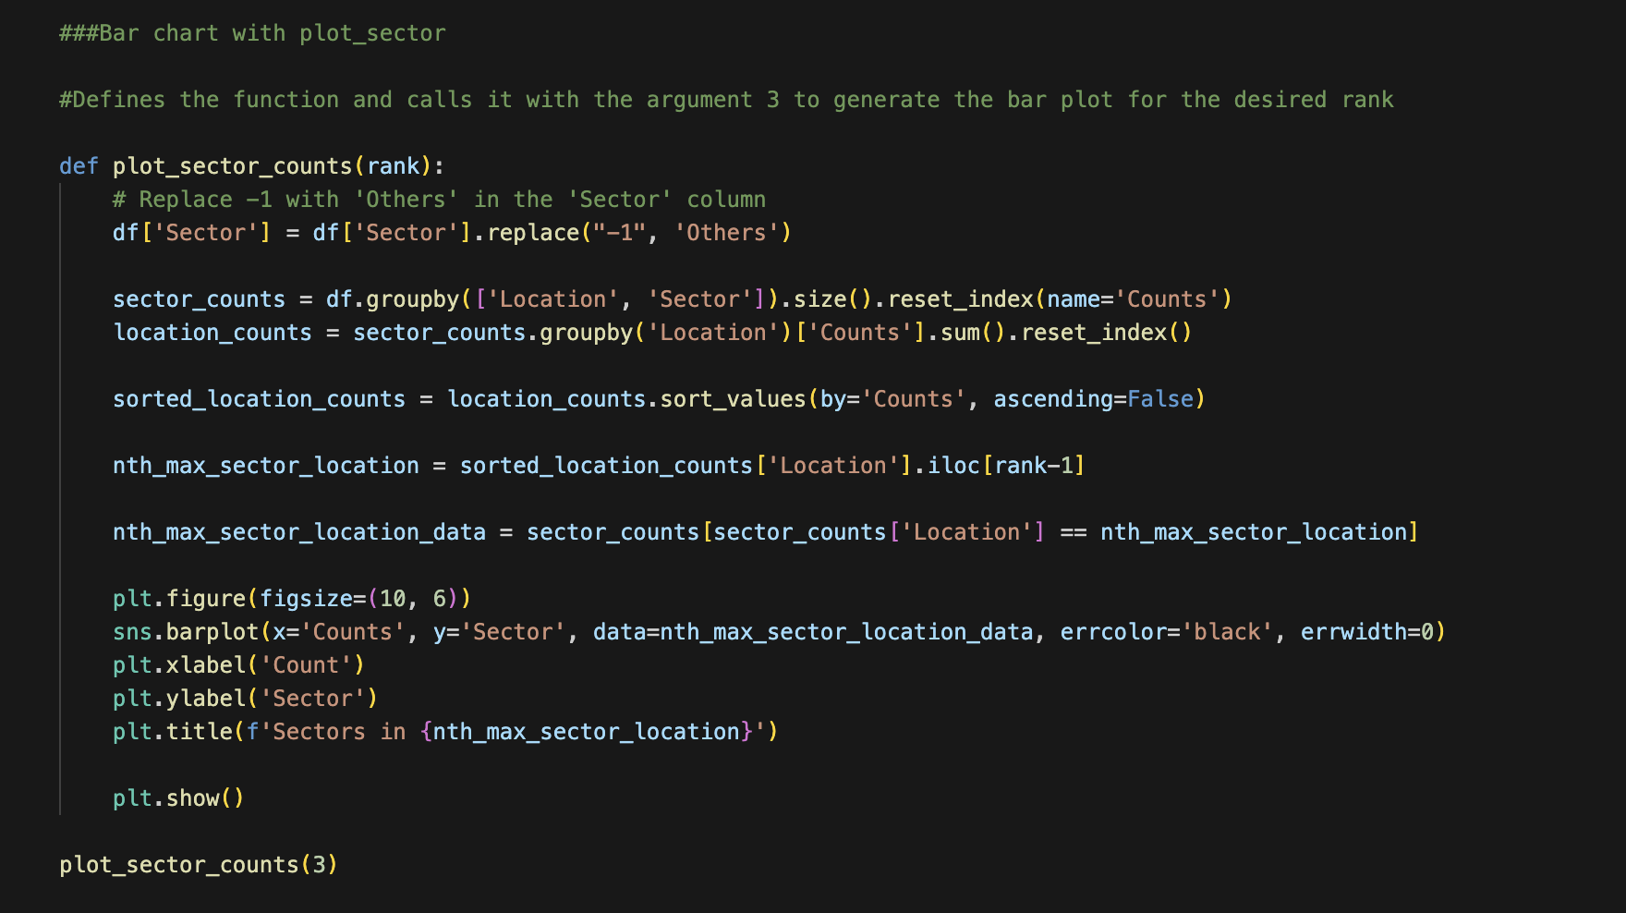
Max Sector Location (Bar Chart)
The bar chart displaying the sectors in the location with the third highest count, illustrating the frequency of each sector. This visualization provides insights into the distribution of sectors within that specific location.

Slide 15
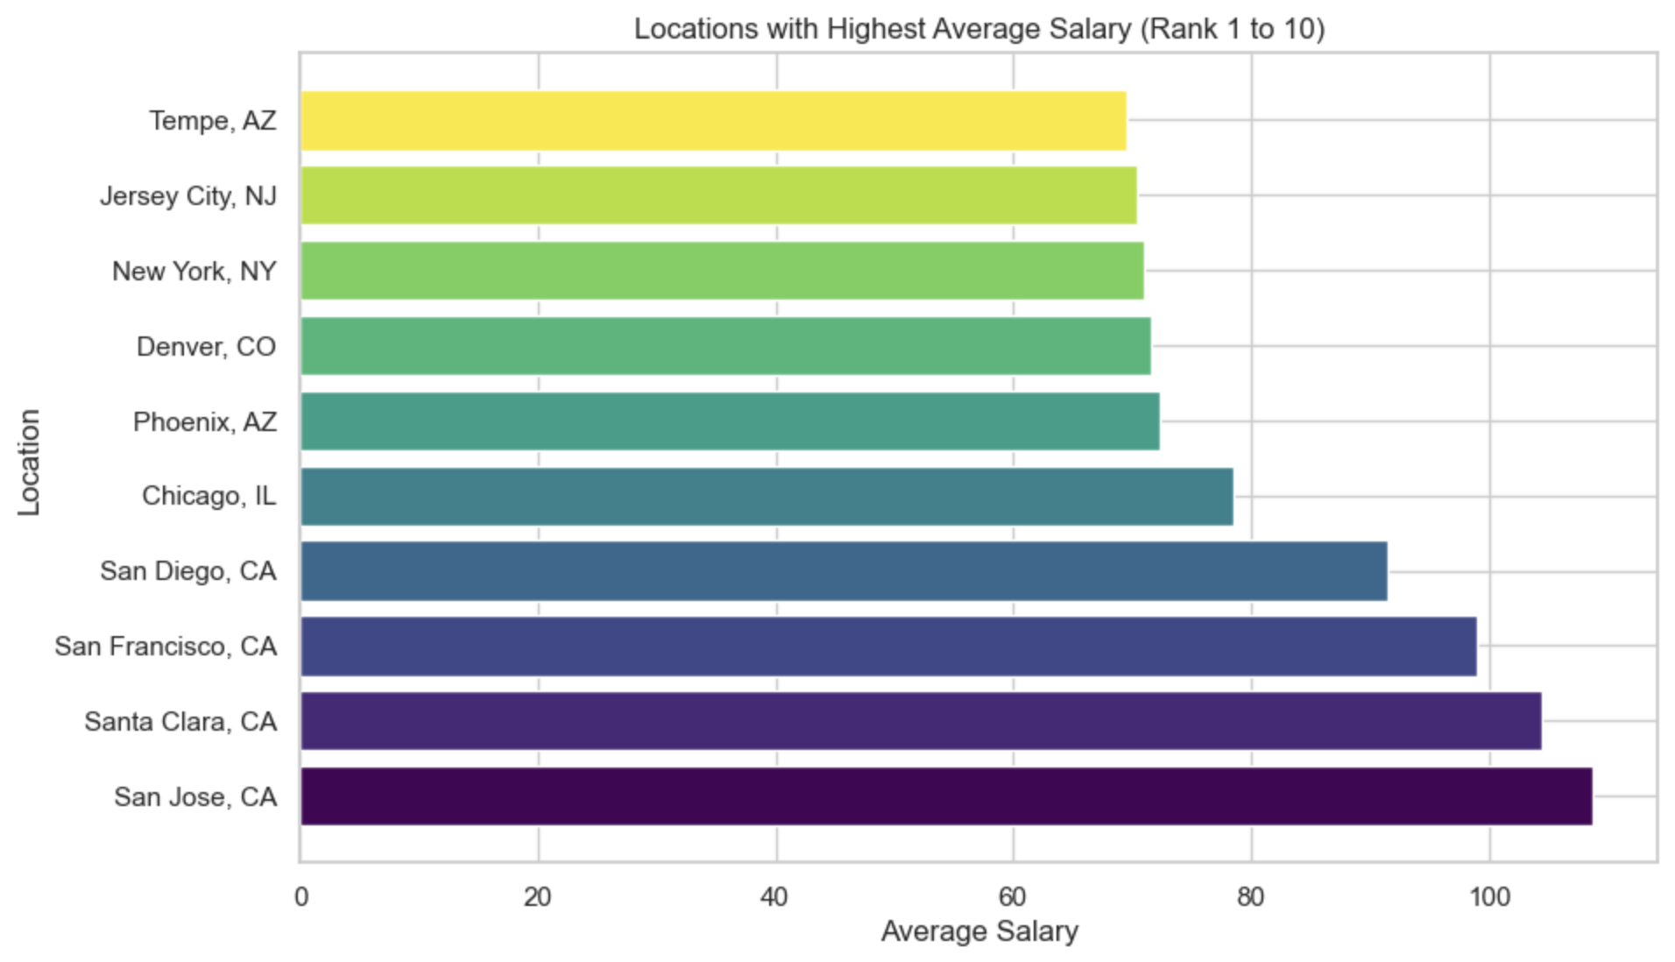
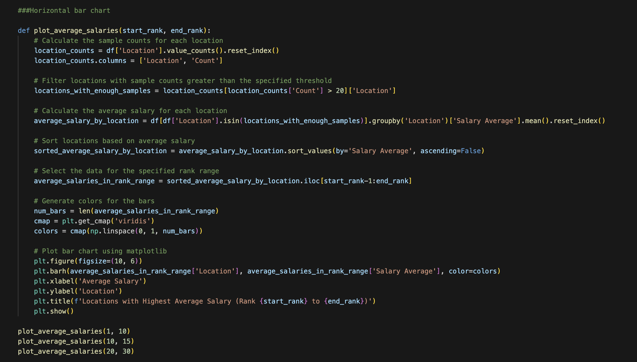
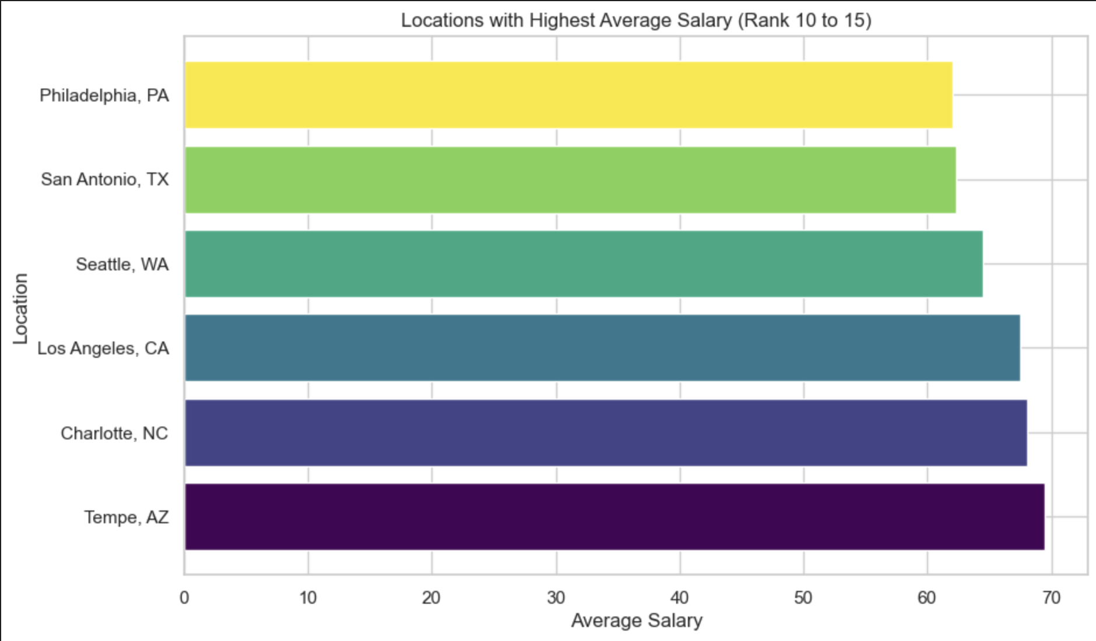
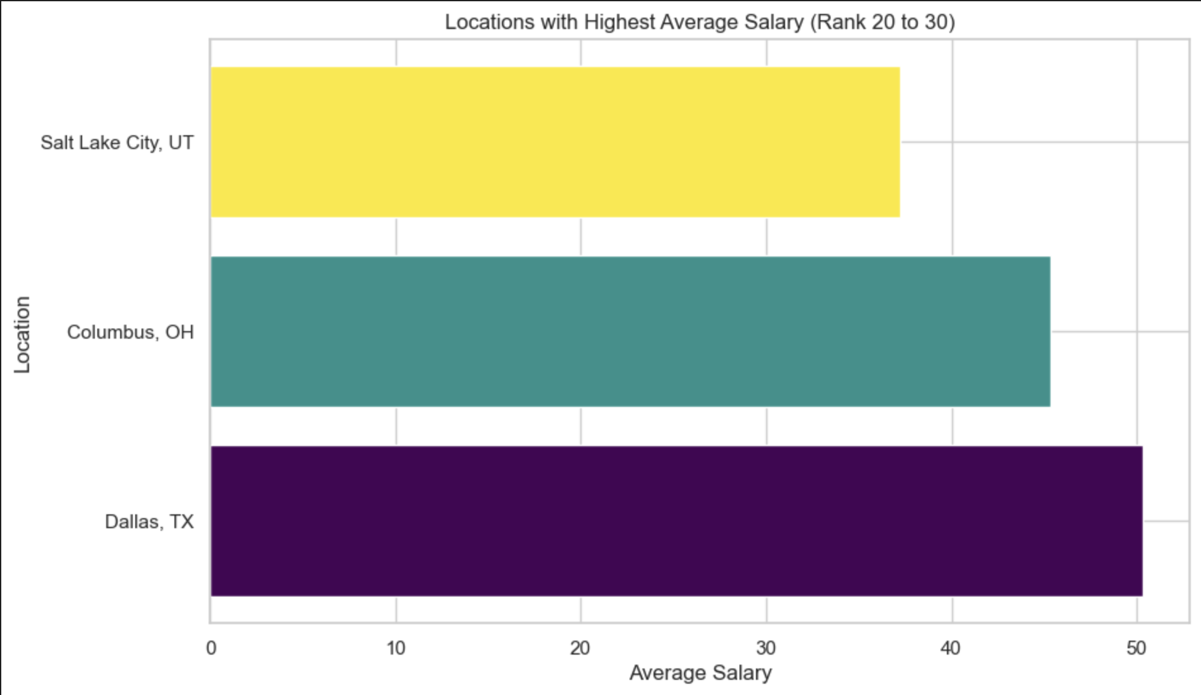
Highest Location Salary
The horizontal bar chart function generates bar charts that display the average salaries of different locations, allowing for easy comparison and identification of locations with the highest average salaries within specified rank ranges.

Slide 16
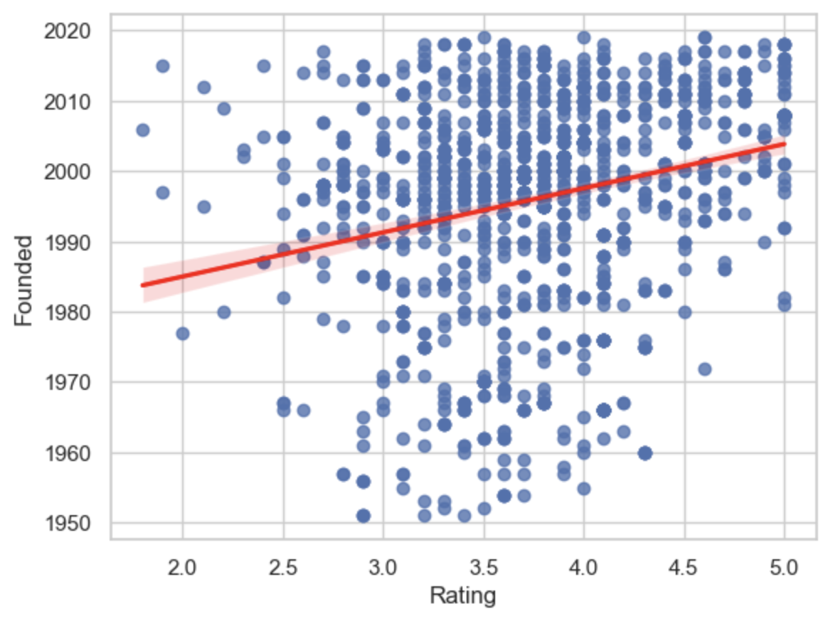
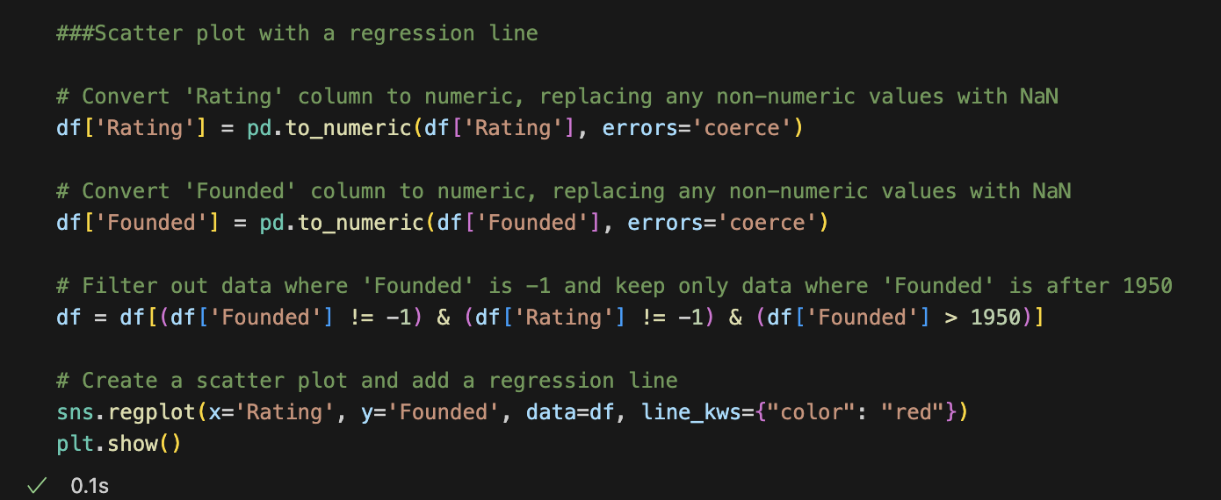
Scatter plot with regression line
The Scatter plot represents the relationship between two variables, ratings and founding years of companies, allowing us to observe any potential patterns, trends, or correlations between them.

Slide 17
Results and insights
The thorough analysis of the dataset has uncovered significant correlations between variables, unveiling previously unknown patterns and relationships. These insights hold great value in informing decision-making processes and deepening our understanding of the underlying mechanisms.
To enhance the clarity of the results, visually engaging representations have been developed. These visual insights offer a comprehensive understanding of the findings, presenting the data analysis results in a vibrant and dynamic manner.
A comparative analysis of the data across different job titles, industries, or company sizes can provide valuable insights into variations and differences in salaries, job descriptions, ratings, and other relevant factors. This analysis can shed light on the distinctive characteristics and requirements of different roles or sectors.

Slide 18
Conclusion

Slide 19
Reference
Data Analyst Jobs
https://www.kaggle.com/datasets/andrewmvd/data-analyst-jobs

